Slide 1
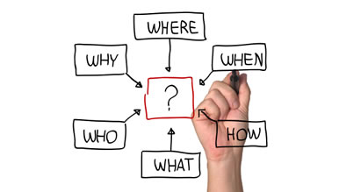
Unit-IV
PLANNING
Dr. Mitesh Hanwate
MBA, NET, SET, Ph.D., PGDHRM
HOD-IIMS
Sahayog Educational Campus

Slide 2
Definitions of Planning
According to Alford and Beatt, “Planning is the thinking process, the organized foresight, the vision based on fact and experience that is required for intelligent action.”
According to Theo Haimann, “Planning is deciding in advance what is to be done. When a manager plans, he projects a course of action for further attempting to achieve a consistent co-ordinate structure of operations aimed at the desired results.
According to Koontz and O’ Donnell, “Planning is an intellectual process, conscious determination of course of action, the basing of decision on purpose, facts and considered estimates.”
According to Allen, “A plan is a trap laid to capture the future.”

Slide 3
FEATURES/NATURE/CHARACTERISTIC OF PLANNING
1. Planning contributes to Objectives
2. Planning is Primary function of management
3. Pervasive
4. Planning is futuristic/Forward looking
5. Planning is continuous
6. Planning involves decision making
7. Planning is a mental exercise
Dr. Mitesh Hanwate- (HOD-IIMS)

Slide 4
IMPORTANCE/SIGNIFICANCE OF PLANNING
1. Planning provides Direction
2. Planning Reduces the risk of uncertainties
3. Planning reduces over lapping and wasteful activities
4. Planning Promotes innovative ideas
5. Planning Facilitates Decision Making
6. Planning establishes standard for controlling
7. Focuses attention on objectives of the company
Dr. Mitesh Hanwate- (HOD-IIMS)

Slide 5
STEPS IN PLANNNIN /PLANNING PROCESS
1.
Setting up of the objectives
6
Follow-up
2. Developing premises
5.
Implement the plan
3.
Listing the various alternatives
4
Selecting an alternative

Slide 6
LIMITATIONS OF PLANNING
1. Planning leads to rigidity
2. Planning may not work in dynamic environment
3. It reduces creativity
4. Planning involves huge Cost
5. It is a time consuming process
6. Planning does not guarantee success
7. Lack of accuracy

Slide 7
MANAGEMENT BY OBJECTIVES

Slide 8
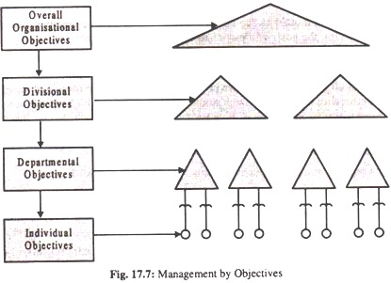
Prof. Peter Drucker

Slide 9
Advantages of MBO
Following are the advantage of MBO:
1. The need to clarify objectives is stressed and suggestion for improvement is obtained from all levels of management.
2. All managers have a clear idea of the important areas of their work and of the standards required.
3. The performance of staff can be assumed and their needs for improvement highlighted.
4. Greater participation may improve morale and communication.
5. It makes individuals more aware of organisational goal.

Slide 10
Disadvantages of MBO
MBO suffers from the following disadvantages also:
1. It takes a few years to be effective.
2. Some companies always tend to raise goals. If these are too high, employees become frustrated.
3. Appraisals are sometimes made on personality traits rather than on performance.
4. Some employees do not want to be held responsible and goals forced upon them may lead to ill-feeling.

Slide 11
DECISION MAKING
Decision-making is the selection based on some criteria from two or more possible alternatives. “-—George R.Terry
A decision can be defined as a course of action consciously chosen from available alternatives for the purpose of desired result —J.L. Massie
Decision–making is a selection process and is concerned with selecting the best type of alternative.
It is concerned with the detailed study of the available alternatives for finding the best possible alternative.

Slide 12
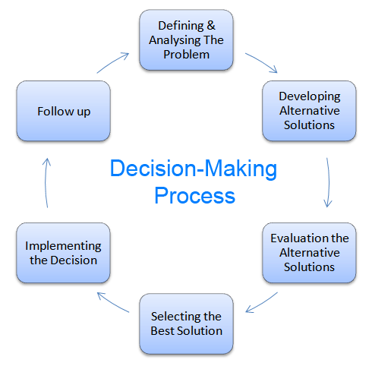
PROCESS OF DECISION MAKING

Slide 13
DECISION TYPES
1. Programmed and non-programmed decisions
2. Routine and strategic decisions
3. Policy and operational decisions
4. Organizational and personal decisions
5. Major and minor decisions
6. Individual and group decisions

Slide 14
ORGANISING
1. Organising is a basic function and a sub-process of management
2. Organising is a continuous process
3. Organising is a function of all managers
4. Organising involves coordination
5. Goal-oriented
6. Group effort
7. Establishes authority-responsibility relationship

Slide 15
IMPORTANCE OF ORGANIZING
1. Provides framework to perform management functions
2. Facilitates coordination
3. Leads to specialisation:
4. Helps in achieving efficiency
5. Promotes Employee development
6. Increases clarity of authority and responsibility
7. Facilitates adaptation

Slide 16
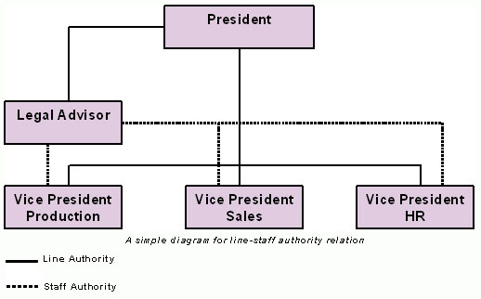
LINE AND STAFF AUTHORITY
Line relationship helps the organization to work properly by
Providing the decisions required for functioning
Furnishing reference points for the approval of proposals
Serving as a means of control by setting the limits of authority
Establishing authentic communication channels to make leadership process effective

Slide 17
TYPES OF BUSINESS ORGANIZATIONAL STRUCTURES

Slide 19
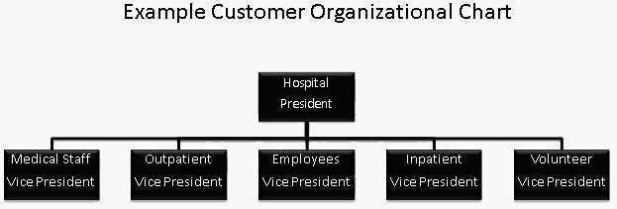
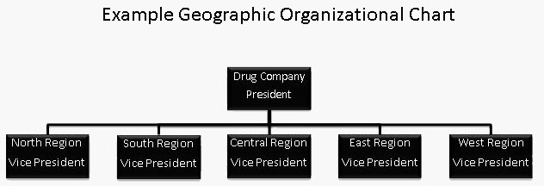

Slide 20
Thank You…!!!

